Slide 1
Day 7: High Performance Computing CMT106
David W. Walker
Professor of High Performance Computing
Cardiff University
http://www.cardiff.ac.uk/people/view/118172-walker-david

Slide 2
Day 7
9:30 – 10:30am: Lecture on dynamic and static load balancing techniques: orthogonal recursive bisection, hierarchical recursive bisection, block cyclic data decompositions.
10:30 – 10:50am: Break.
10:50am – 11:40pm: Lecture on cellular automaton model of catalytic converter.
11:40 – 1:10pm: Lunch break.
1:10 – 3:00pm: Self study, do the questions on the worksheet.
3:00 – 4:30pm: Review of the worksheet questions.
4:30 – 5:00pm: Review module, structure of the exam.

Slide 3
Topics Covered on Days 1-4
Day 1: Introduction to parallelism; motivation; types of parallelism; Top500 list; classification of machines; SPMD programs; memory models; shared and distributed memory; OpenMP; example of summing numbers.
Day 2: Interconnection networks; network metrics; classification of parallel algorithms; speedup and efficiency.
Day 3: Scalable algorithms; Amdahl's law; sending and receiving messages; programming with MPI; collective communication; integration example.
Day 4: Regular computations and simple examples – the wave equation and Laplace’s equation.

Slide 4
Topics Covered on Days 5-7
Day 5: Programming GPUs with CUDA; CUDA device memory architecture; simple programming examples.
Day 6: Dynamic communication and the molecular dynamics example; irregular computations; the WaTor simulation.
Day 7: Load balancing strategies; block-cyclic data distribution, surface catalysis model.

Slide 5
Dynamic Load Imbalance
In dealing with dynamic load imbalance the following two approaches are important:
Use of a dynamic load balancer so that the distribution of the ocean among the processes changes as the fish and shark system evolves. When dealing with grids some form of recursive bisection is often used.
Use of a cyclic, or scattered, data distribution. The parts of the grid assigned to one process do not form a contiguous block but are scattered in a regular way over the whole domain. The aim in this case is to achieve statistical load balance.

Slide 6
Orthogonal Recursive Bisection
Orthogonal Recursive Bisection (ORB) first divides the domain orthogonal to the x-direction so there are equal numbers of items in each of the two subdomains.
Then each of these 2 subdomains is independently divided orthogonal to the y-direction, to give 4 subdomains each with approximately the same number of items in each
This process of bisection continues, alternating between the x and y directions, until there is one subdomain for each process.

Slide 7
Example of ORB 1
ORB is not used when the items are distributed uniformly over the domain - in this case the subdomains would come out about the same size and shape.

Slide 8
Example of ORB 2
If the items are distributed unevenly over the domain, ORB can give rise to a variety of different shaped process subdomains.

Slide 9
Notes on ORB
Using a dynamic load balance scheme such as ORB adds to the complexity of the software, particularly in deciding which boundary data must be communicated with which processes.

Slide 10
Hierarchical Recursive Bisection
HRB is a variation of ORB in which we first make all the cuts in one direction, and then all the cuts in the second direction, rather than alternating directions.
HRB allows the data distribution to be adjusted over just one direction, rather than both.
ORB and HRB can easily be extended to 3 or more dimensions.

Slide 11
Example of HRB

Slide 12
Cyclic Data Distributions
In a cyclic data distribution the data assigned to each process is scattered in a regular way over the domain of the problem.
The figure on the next slide shows how a grid might be cyclically distributed over a 4x4 mesh of processes.
The cyclic distribution is a simple way to improve load balance but can result in more communication as it increases the amount of boundary data in a process.

Slide 13
(0,0)
(0,1)
(0,2)
(0,3)
(0,0)
(0,1)
(0,2)
(0,3)
(0,0)
(0,1)
(0,2)
(0,3)
(1,0)
(1,1)
(1,2)
(1,3)
(1,0)
(1,1)
(1,2)
(1,3)
(1,0)
(1,1)
(1,2)
(1,3)
(2,0)
(2,1)
(2,2)
(2,3)
(2,0)
(2,1)
(2,2)
(2,3)
(2,0)
(2,1)
(2,2)
(2,3)
(3,0)
(3,1)
(3,2)
(3,3)
(3,0)
(3,1)
(3,2)
(3,3)
(3,0)
(3,1)
(3,2)
(3,3)
(0,0)
(0,1)
(0,2)
(0,3)
(0,0)
(0,1)
(0,2)
(0,3)
(0,0)
(0,1)
(0,2)
(0,3)
(1,0)
(1,1)
(1,2)
(1,3)
(1,0)
(1,1)
(1,2)
(1,3)
(1,0)
(1,1)
(1,2)
(1,3)
(2,0)
(2,1)
(2,2)
(2,3)
(2,0)
(2,1)
(2,2)
(2,3)
(2,0)
(2,1)
(2,2)
(2,3)
(3,0)
(3,1)
(3,2)
(3,3)
(3,0)
(3,1)
(3,2)
(3,3)
(3,0)
(3,1)
(3,2)
(3,3)
(0,0)
(0,1)
(0,2)
(0,3)
(0,0)
(0,1)
(0,2)
(0,3)
(0,0)
(0,1)
(0,2)
(0,3)
(1,0)
(1,1)
(1,2)
(1,3)
(1,0)
(1,1)
(1,2)
(1,3)
(1,0)
(1,1)
(1,2)
(1,3)
(2,0)
(2,1)
(2,2)
(2,3)
(2,0)
(2,1)
(2,2)
(2,3)
(2,0)
(2,1)
(2,2)
(2,3)
(3,0)
(3,1)
(3,2)
(3,3)
(3,0)
(3,1)
(3,2)
(3,3)
(3,0)
(3,1)
(3,2)
(3,3)

Slide 14
Cyclic Data Distributions
Consider a one-dimensional cyclic data distribution of an array, such as:
0
1
2
3
0
1
2
3
0
1
2
3
0
1
2
3
This is known as a cyclic[1] data distribution, and can be regarded as mapping a global index, m, to a process location, p, and a local index, i.

Slide 15
Cyclic[1] Data Mappings
The global index, m, maps to a process location, p, and a local index, i.
m ➔ (p,i)
where p and i are given by:
p = m (mod N)
i = floor(m/N)
and N is the number of processes. The inverse mapping is:
m = iN + p

Slide 16
Cyclic[k] Data Mappings
If we arrange array entries in groups of size k and cyclically distribute these we get a cyclic[k] data distribution.
For example, the following shows a cyclic[2] data distribution.
0
0
1
1
2
2
3
3
0
0
1
1
2
2
3
3
http://users.cs.cf.ac.uk/David.W.Walker/PHP/CyclicTable.php

Slide 17
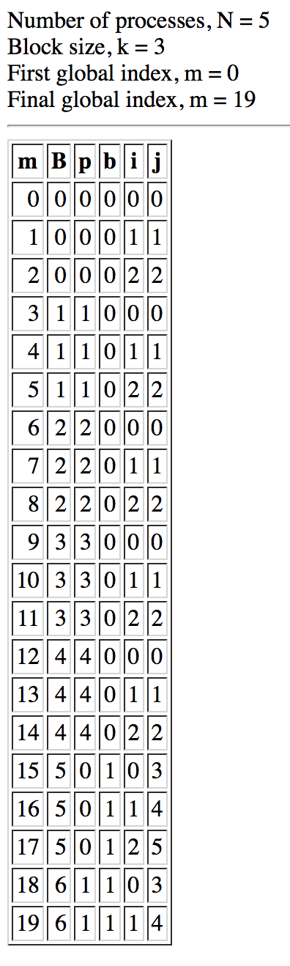
Cyclic[k] Example
m is the global index
B is the global block index
p is the process number
b is the local block index
i is the local index within the block
j is the local index in the process
j = kb + i
where k is the block size

Slide 18
Cyclic[k] Data Mappings 2
Global index m is mapped to process location p, local block index b, and local index i within the block, as follows:
p = B (mod N)
b = floor(B/N)
i = m (mod k)
where B=floor(m/k) is the global block index. The inverse mapping is:
m=(bN+p)k + i

Slide 19
Communication and Load Imbalance Tradeoff
A block cyclic data distribution can be used to improve load balance when data is distributed inhomogeneously across the problem domain.
However, a smaller block size results in more boundary data and hence gives rise to increased communication.
There is, therefore, a tradeoff between load imbalance and communication cost.
It is important to choose the correct block size so that the total overhead is minimised.

Slide 20
Example
Assume that the amount of communication associated with a block is proportional to its perimeter.
Suppose we have a 2-D block cyclic distribution with block size k₁ by k₂.
Now we reduce the block size by a factor of 2 in each direction, so each block in the original data distribution is split into 4 blocks, each of size k₁/2 by k₂ /2.

Slide 21
Example (continued)
Perimeter = 2(k₁+k₂)
Perimeter = 2(k₁/2+k₂/2) = k₁+k₂
The perimeter of the original block is 2(k₁+k₂).
After it is split into 4 smaller blocks the total perimeter of these blocks is 4(k₁+k₂).
So, for a 2D problem, we expect the communication cost to double when the block size is halved in each direction

Slide 22
Multi-Dimensional Data Distributions
Multi-dimensional arrays are distributed by applying the desired data distribution separately to each array index.
Thus, for a two-dimensional data distribution the global index (m,n) is mapped so that m➔ (p,i) and n ➔ (q,j), where (p,q) is location on a PxQ process mesh, and (i,j) is the index into the local 2D array.
Different data distributions can be applied over each array dimension.

Slide 23
Multi-Dimensional Data Distributions 2
For a 2D (cyclic[1],cyclic[1]) data distribution we would have:
m ➔ (p,i) = (m(mod P), floor(m/P))
n ➔ (q,j) = (n(mod Q), floor(n/Q))

Slide 24
(0,0)
(0,1)
(0,2)
(0,3)
(0,0)
(0,1)
(0,2)
(0,3)
(0,0)
(0,1)
(0,2)
(0,3)
(1,0)
(1,1)
(1,2)
(1,3)
(1,0)
(1,1)
(1,2)
(1,3)
(1,0)
(1,1)
(1,2)
(1,3)
(2,0)
(2,1)
(2,2)
(2,3)
(2,0)
(2,1)
(2,2)
(2,3)
(2,0)
(2,1)
(2,2)
(2,3)
(3,0)
(3,1)
(3,2)
(3,3)
(3,0)
(3,1)
(3,2)
(3,3)
(3,0)
(3,1)
(3,2)
(3,3)
(0,0)
(0,1)
(0,2)
(0,3)
(0,0)
(0,1)
(0,2)
(0,3)
(0,0)
(0,1)
(0,2)
(0,3)
(1,0)
(1,1)
(1,2)
(1,3)
(1,0)
(1,1)
(1,2)
(1,3)
(1,0)
(1,1)
(1,2)
(1,3)
(2,0)
(2,1)
(2,2)
(2,3)
(2,0)
(2,1)
(2,2)
(2,3)
(2,0)
(2,1)
(2,2)
(2,3)
(3,0)
(3,1)
(3,2)
(3,3)
(3,0)
(3,1)
(3,2)
(3,3)
(3,0)
(3,1)
(3,2)
(3,3)
(0,0)
(0,1)
(0,2)
(0,3)
(0,0)
(0,1)
(0,2)
(0,3)
(0,0)
(0,1)
(0,2)
(0,3)
(1,0)
(1,1)
(1,2)
(1,3)
(1,0)
(1,1)
(1,2)
(1,3)
(1,0)
(1,1)
(1,2)
(1,3)
(2,0)
(2,1)
(2,2)
(2,3)
(2,0)
(2,1)
(2,2)
(2,3)
(2,0)
(2,1)
(2,2)
(2,3)
(3,0)
(3,1)
(3,2)
(3,3)
(3,0)
(3,1)
(3,2)
(3,3)
(3,0)
(3,1)
(3,2)
(3,3)

Slide 25
(cyclic[k_{r}],cyclic[k_{c}]) Example
Take (k_{r},k_{c}) = (3,4) and (P,Q) = (5,4). Then where is element (m,n) = (18,22)?
Rows: m = 18, k_{r} = 3, P = 5
B_{r} = 18/3 = 6,
p = B(mod P) = 1, b_{r} = B/P = 1, i_{r} = m(mod k_{r}) = 0
Columns: n = 22, k_{c} = 4, Q = 4
B_{c} = 22/4 = 5,
q = B(mod Q) = 1, b_{c} = B/Q = 1, i_{c} = n(mod k_{c}) = 2

Slide 26
Position of (18,22)
Q = 4
B_{c}=5
P = 5
i_{c}=2
i_{r}=0
B_{r}=6
Block (B_{r},B_{c})=(6,5)
Each green rectangle is a 3x4 block
Position in process mesh is (p,q) = (1,1)
Local block position is (b_{r},b_{c}) = (1,1)

Slide 27
Layout of Global Blocks: Matrix View
B_{c}
B_{r}

Slide 28
Layout of Global Blocks: Process Memory View
B_{r} ,B_{c}

Slide 29
Load Balancing Issues in a Parallel Cellular Automata Application
This looks at an application that uses a cyclic data distribution to achieve static load balance.
As in WaTor, data inconsistency in how updates are performed is an issue

Slide 30
CA for Surface Reactions
A cellular automaton is used to model the reaction of carbon monoxide and oxygen to form carbon dioxide
CO + O CO₂
Reactions take place on surface of a crystal which serves as a catalyst.

Slide 31
The Problem Domain
The problem domain is a periodic square lattice representing the crystal surface.
CO and O₂ are adsorbed onto the crystal surface from the gas phase.
Parameter y is the fraction of CO and 1-y is the fraction of O₂.

Slide 32
Interaction Rules
Choose a lattice site at random and attempt to place a CO or an O₂ there with probabilities y and 1-y, respectively.
If site is occupied then the CO or O₂ bounces off, and a new trial begins.
O₂ disassociates so we have to find 2 adjacent sites for these.
The following rules determine what happens next.

Slide 33
Interaction Rules for CO
1. CO adsorbed
2. Check 4 neighbors for O
oxygen
3. CO and O react
CO
4. CO₂ desorbs

Slide 34
Interaction Rules for O
1. O₂ adsorbed
2. O₂ disassociates
oxygen
3. Check 6 neighbors for CO
CO
4. O and CO react
O₂
5. CO₂ desorbs

Slide 35
Parallel Version of Code
As simulation evolves the distribution of molecules may become very uneven.
This results in load imbalance.
Use a 2-D block cyclic data distribution for the lattice.
This will give statistical load balance, but smaller block sizes will result in more communication.

Slide 36
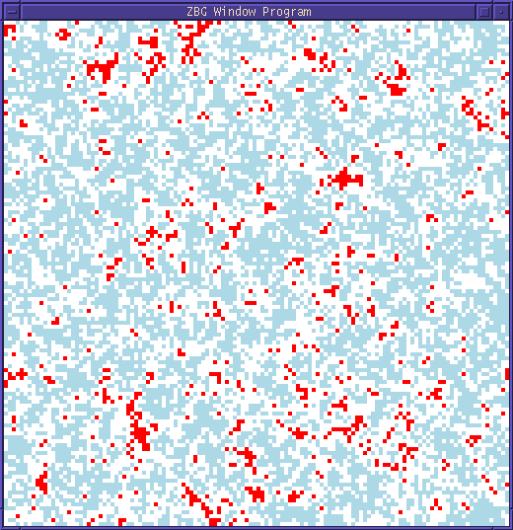
Steady State Reaction
For y₁<y<y₂ we get
a steady state.
y₁ ≈ 0.39
y₂ ≈ 0.53

Slide 37
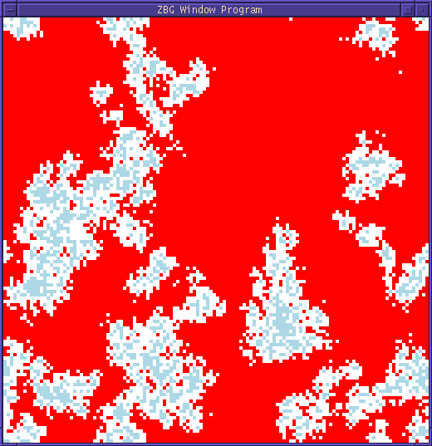
CO Poisoning: y > y₂

Slide 38
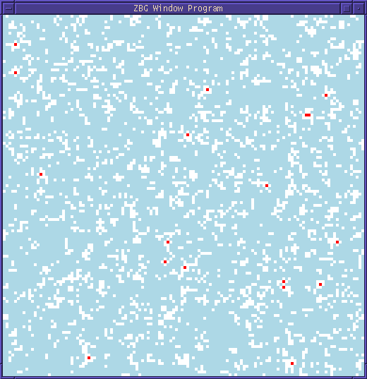
Oxygen Poisoning: y < y₁

Slide 39

Oxygen Poisoning
y = 0.36

Slide 40
CO Poisoning
y = 0.53

Slide 41

Steady State
y = 0.525

Slide 42
Main Issues
MPI used – user-defined datatypes were important in performing communication.
There is a trade-off between load imbalance and communication.
A block-cyclic data distribution is used.
Performance can be modelled.

Slide 43
Block-Cyclic Data Distribution
(0,0)
(0,1)
(0,2)
(0,3)
(0,0)
(0,1)
(0,2)
(0,3)
(0,0)
(0,1)
(0,2)
(0,3)
Block-cyclic data
distribution improves
load balance by scattering
processes over the lattice
in a regular way.
(1,0)
(1,1)
(1,2)
(1,3)
(1,0)
(1,1)
(1,2)
(1,3)
(1,0)
(1,1)
(1,2)
(1,3)
(2,0)
(2,1)
(2,2)
(2,3)
(2,0)
(2,1)
(2,2)
(2,3)
(2,0)
(2,1)
(2,2)
(2,3)
(3,0)
(3,1)
(3,2)
(3,3)
(3,0)
(3,1)
(3,2)
(3,3)
(3,0)
(3,1)
(3,2)
(3,3)
(0,0)
(0,1)
(0,2)
(0,3)
(0,0)
(0,1)
(0,2)
(0,3)
(0,0)
(0,1)
(0,2)
(0,3)
(1,0)
(1,1)
(1,2)
(1,3)
(1,0)
(1,1)
(1,2)
(1,3)
(1,0)
(1,1)
(1,2)
(1,3)
(2,0)
(2,1)
(2,2)
(2,3)
(2,0)
(2,1)
(2,2)
(2,3)
(2,0)
(2,1)
(2,2)
(2,3)
Block size is k_{r} x k_{c}
(3,0)
(3,1)
(3,2)
(3,3)
(3,0)
(3,1)
(3,2)
(3,3)
(3,0)
(3,1)
(3,2)
(3,3)
(0,0)
(0,1)
(0,2)
(0,3)
(0,0)
(0,1)
(0,2)
(0,3)
(0,0)
(0,1)
(0,2)
(0,3)
(1,0)
(1,1)
(1,2)
(1,3)
(1,0)
(1,1)
(1,2)
(1,3)
(1,0)
(1,1)
(1,2)
(1,3)
(2,0)
(2,1)
(2,2)
(2,3)
(2,0)
(2,1)
(2,2)
(2,3)
(2,0)
(2,1)
(2,2)
(2,3)
(3,0)
(3,1)
(3,2)
(3,3)
(3,0)
(3,1)
(3,2)
(3,3)
(3,0)
(3,1)
(3,2)
(3,3)

Slide 44
Parallel Implementation
Processes need to communicate their boundary data to neighboring processes.
Sites within two sites from the boundary must be communicated.
Each process can generate random numbers independently.

Slide 45
A Communication Strategy
Do a left shift: send leftmost 2 columns left while receiving from the right.
Do a right shift: send rightmost 2 columns right while receiving from the left.
Similarly for up shifts and down shifts.
After these 4 shifts have been done each process can update all its lattice sites.

Slide 46
Communication Shifts
1. Left shift.
2. Right shift.
3. Up shift.
4. Down shift.

Slide 47
Update Conflicts
Two adjacent processes can concurrently update the same lattice site close to their common boundary.
This is an update conflict.
Avoid conflicts by never updating adjacent areas in processes concurrently.
Use sub-partitioning to do this.

Slide 48
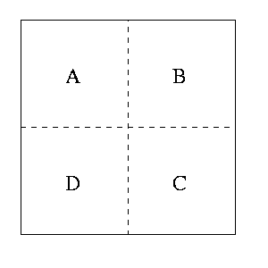
Sub-partitioning
First each process updates A, then B, C, and D.
Before updating a sub-partition communication is needed to ensure each process has all the data to update its points.
After updating a sub-partition the data is sent back to the process it came from.

Slide 49
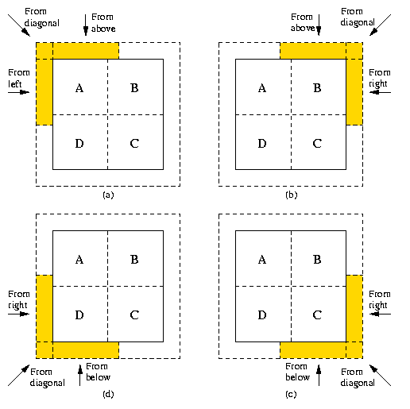
Communication Before Update
From left

Slide 50
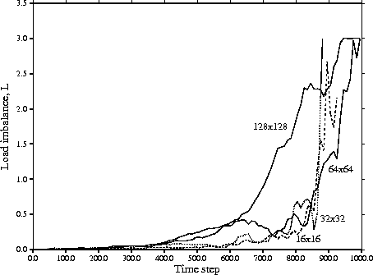
Load Imbalance
2x2 process mesh
used.
512x512 lattice
y = 0.53
Load imbalance is
smaller for smaller
block sizes.
Load imbalance is
large as CO
poisoning occurs.

Slide 51
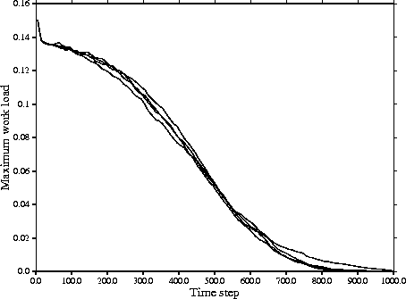
Maximum Work Load
Maximum work
load is similar
for different
block size, except
after step 700.
Not much work
available at this
time.
Load imbalance
not very
important!

Slide 52
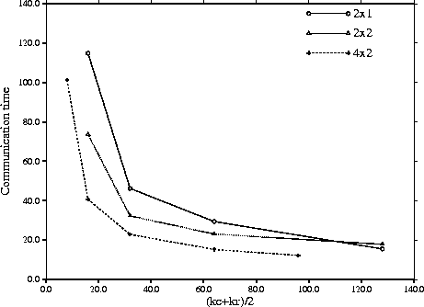
Communication Time
512x512 lattice,
y = 0.53
For given problem
communication is
smaller for more
processes - less
data per process.
Process mesh
Smaller blocks
require more
communication.

Slide 53
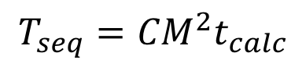
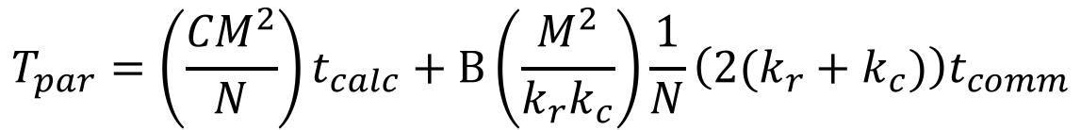
Performance Model
Amount of communication and computation both depend linearly on problem size.
Speed-up is independent of problem size and is given by:
Number of blocks per process
$$T_{seq}={CM}^{2}t_{calc}$$
$$T_{par}=\left(\frac{{CM}^{2}}{N}\right)t_{calc}+B\left(\frac{M^{2}}{k_{r}k_{c}}\right)\frac{1}{N}\left(2(k_{r}+k_{c})\right)t_{comm}$$
S = N
Perimeter of block
1 + A τ (k_{r}+k_{c})/(k_{r} k_{c})

Slide 54
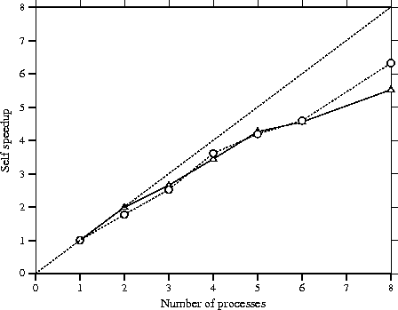
Self Speed-Up
As expected,
speed-up is
independent of
problem size
(except at 8!)
480x480
128x128

Slide 55
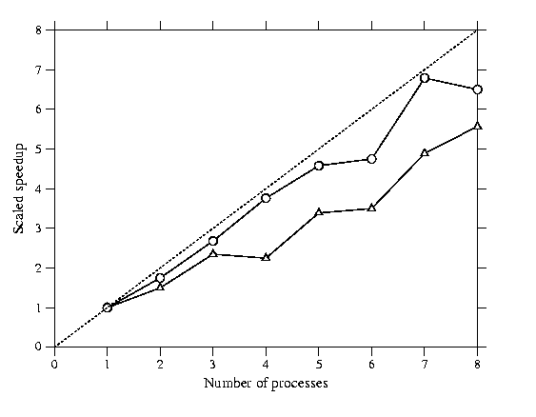
Scaled Speed-Up
Fixed problem size
per process
480x480
128x128

Slide 56
Summary
It turns out that load imbalance is not very important in this problem.
Load imbalance will be important in cellular automata with more complex geometries.
Easy to modify code for other CA problems.
Speed-up independent of problem size.

